Slide 1
Empowering and enabling the logistics industry globally.
Structural Design Patterns
Nancy Li
Software Developer
20 Mar 2023

Slide 2
Design Patterns
Structural Design Patterns
Behavioral Design Patterns
Creational Design Patterns
Notes:
Design patterns are typical solutions to commonly occurring problems in software design.
When a solution gets repeated over and over in various projects, someone eventually puts a name to it and describes the solution in detail. That’s basically how a pattern gets discovered.
You can follow the pattern details and implement a solution that suits the realities of your own program.
Design patterns are divided into three main categories
The first category is Creational patterns, for which I made a presentation last year.
The second is Structural patterns. That's what I want to talk about today.
Structural patterns explain how to assemble objects and classes into larger structures, while keeping these structures flexible and efficient.
Creational patterns provide object creation mechanisms that increase flexibility and reuse of existing code.
Behavioral patterns take care of effective communication and the assignment of responsibilities between objects.

Slide 3
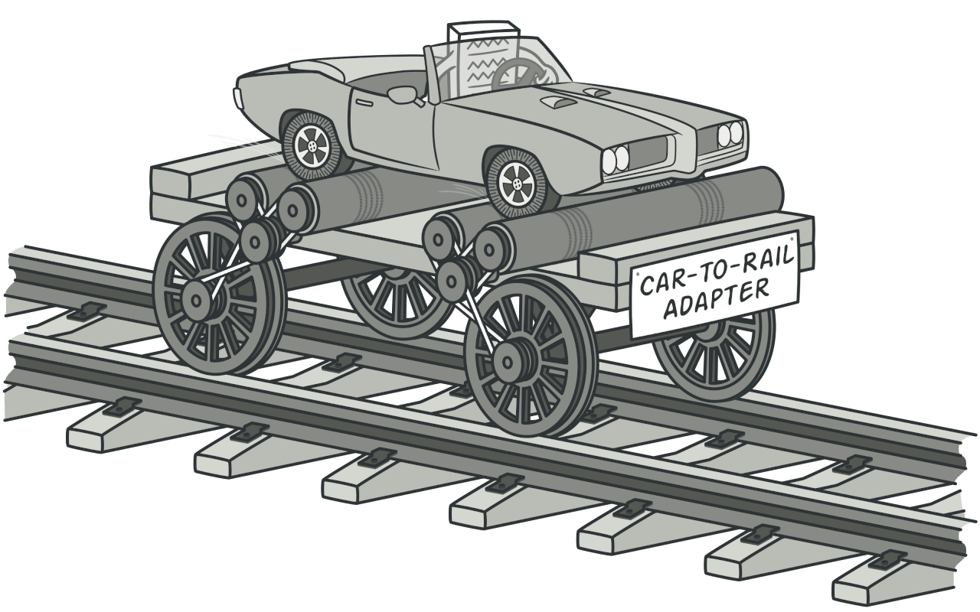
1. Adapter
Notes:
Imagine that there is a rail in front of you, but you only have a car. How can you get to your destination?
As you can see in the picture, we may need a “Car to Rail Adapter”.
The Adapter pattern allows objects with incompatible interfaces to collaborate.
So how can we implement it in actual code? Let's take a look at the example.

Slide 4
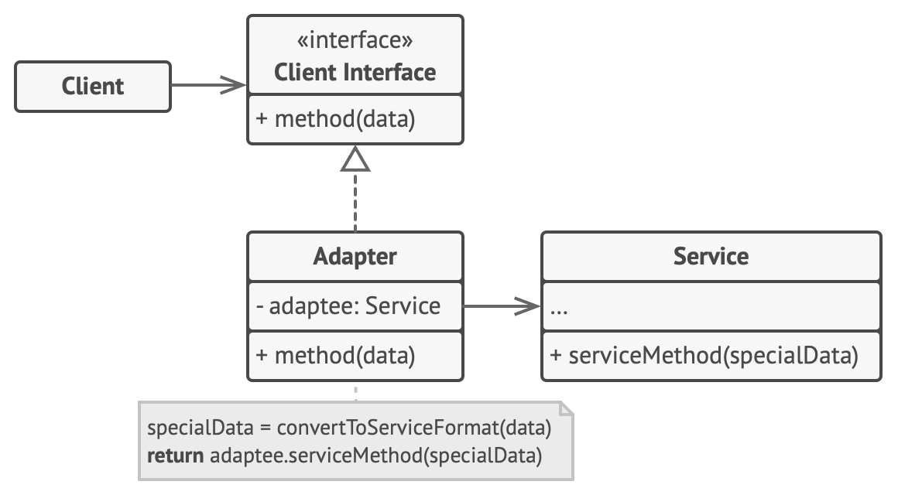
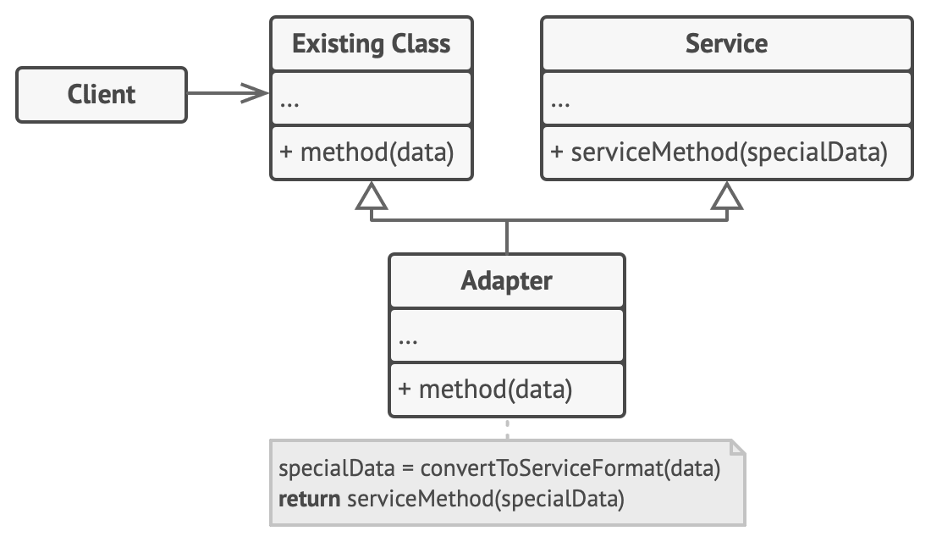
1. Adapter
Target (Client Interface)
Adaptee (Service)
Adapter
Object Adapter
Class Adapter
Notes:
Depending on the implementation, it can also be divided into Object Adapter and Class Adapter.
The Client Interface describes a protocol that other classes must follow to be able to collaborate with the client code.
The Service is some useful class (usually 3rd-party or legacy). The client can’t use this class directly because it has an incompatible interface.
The Adapter is a class that’s able to work with both the client and the service: it implements the client interface, while wrapping the service object.
The adapter receives calls from the client via the adapter interface and translates them into calls to the wrapped service object in a format it can understand.

Slide 5
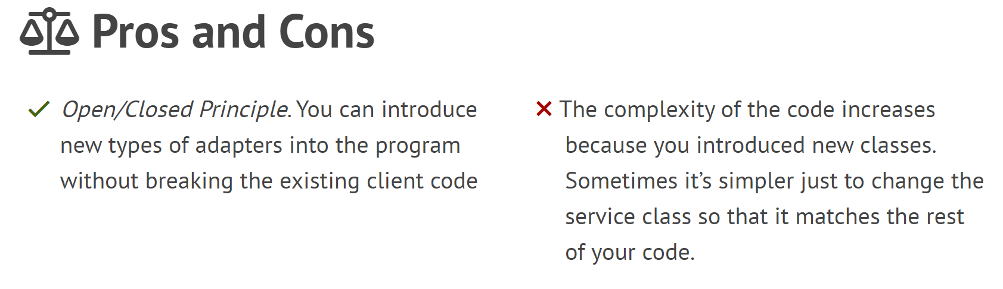
1. Adapter
Notes:
In object-oriented programming, the open/closed principle states "software entities (classes, modules, functions, etc.) should be open for extension, but closed for modification";
That is, such an entity can allow its behavior to be extended without modifying its source code.
This is especially valuable in a production environment, where changes to source code may necessitate code reviews, unit tests, and other such procedures to qualify it for use in a product: code obeying the principle doesn't change when it is extended, and therefore needs no such effort.

Slide 6
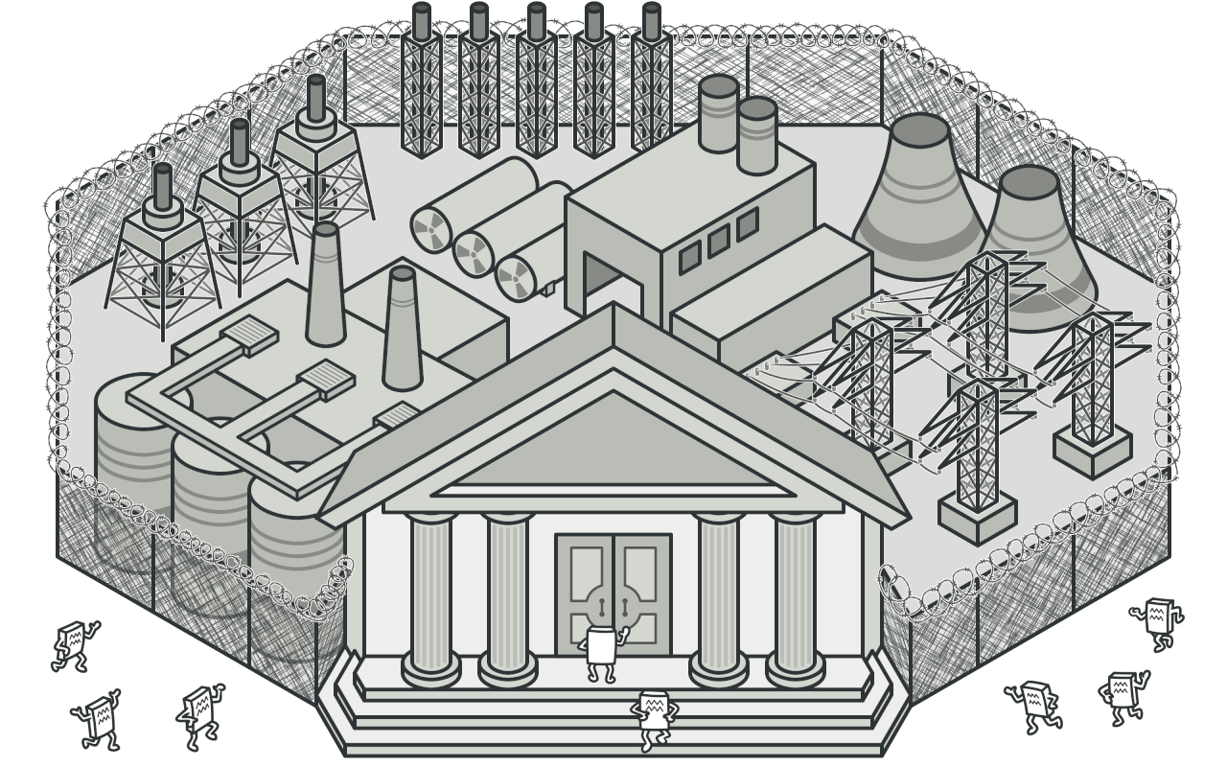
2. Facade
Notes:
Imagine that you must make your code work with a broad set of objects. Those objects belong to a complex library or framework.
Usually, you’d need to initialize all these objects, keep track of dependencies, execute methods in the correct order, and so on.
As a result, the business logic of your classes would become tightly coupled to the implementation details of these objects, making it hard to maintain.
Facade provides a simplified interface to a library, a framework, or any other complex set of classes.

Slide 7
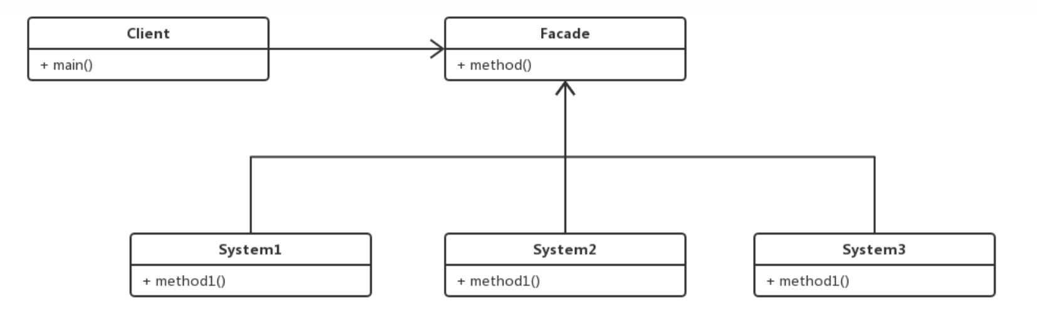
2. Facade
Sub System
Facade
Notes:
The Facade provides convenient access to a particular part of the subsystem’s functionality. It knows where to direct the client’s request and how to operate all the moving parts.
The Complex Subsystem consists of dozens of various objects.
To make them all do something meaningful, you must dive deep into the subsystem’s implementation details, such as initializing objects in the correct order and supplying them with data in the proper format.
Subsystem classes aren’t aware of the facade’s existence. They operate within the system and work with each other directly.

Slide 8
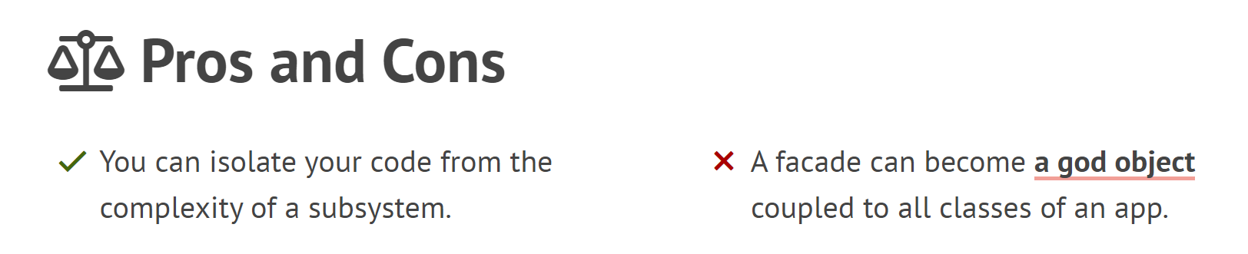
2. Facade
Notes:
Since the client code won’t get into complex logic of one or several subsystems.
However, the Facade delegates the requests to subsystem.
Subsystems often get more complex over time. The configuration it requires grows ever larger.
The Facade attempts to fix this problem by providing a shortcut to the most-used features of the subsystem which fit most client requirements.

Slide 9
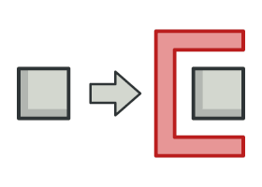
3. Proxy
Notes:
Proxy lets you provide a substitute or placeholder for another object.
A proxy controls access to the original object, allowing you to perform something either before or after the request gets through to the original object.

Slide 10
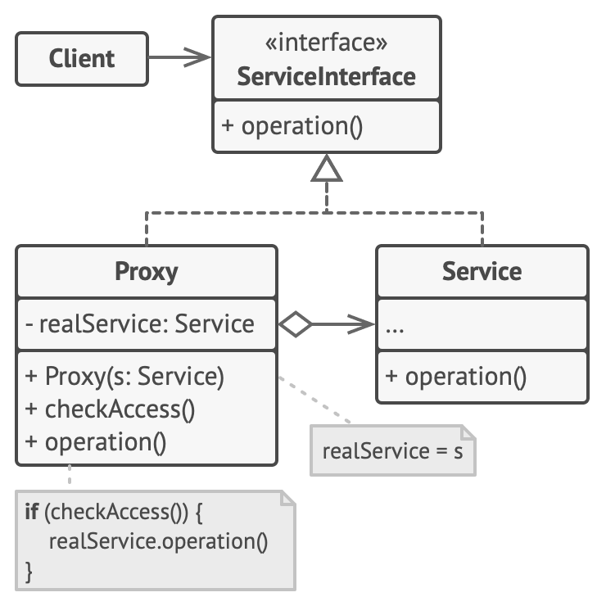
3. Proxy
Subject (Service Interface)
Real Subject (Service)
Proxy
Notes:
The Service Interface declares the interface of the Service. The proxy must follow this interface to be able to disguise itself as a service object.
The Service is a class that provides some useful business logic.
The Proxy class has a reference field that points to a service object.
After the proxy finishes its processing (e.g., lazy initialization, logging, access control, caching, etc.), it passes the request to the service object.
Usually, proxy manage the full lifecycle of their service objects.

Slide 11
3. Proxy
Protection Proxy - Access control
Remote Proxy - Local execution of a remote service
logging Proxy - Logging requests
Caching Proxy - Caching request results
……
Notes:
There are four commonly used scenarios for the proxy parttern:
Protection Proxy, can pass the request to the service object under certain conditions.
Remote Proxy, can pass the client request over the network, handling all of the details of working with the network.
Logging Proxy, can log each request before passing it to the service.
Caching Proxy, can implement caching for recurring requests that always return the same results. The proxy may use the parameters of requests as the cache keys.

Slide 12
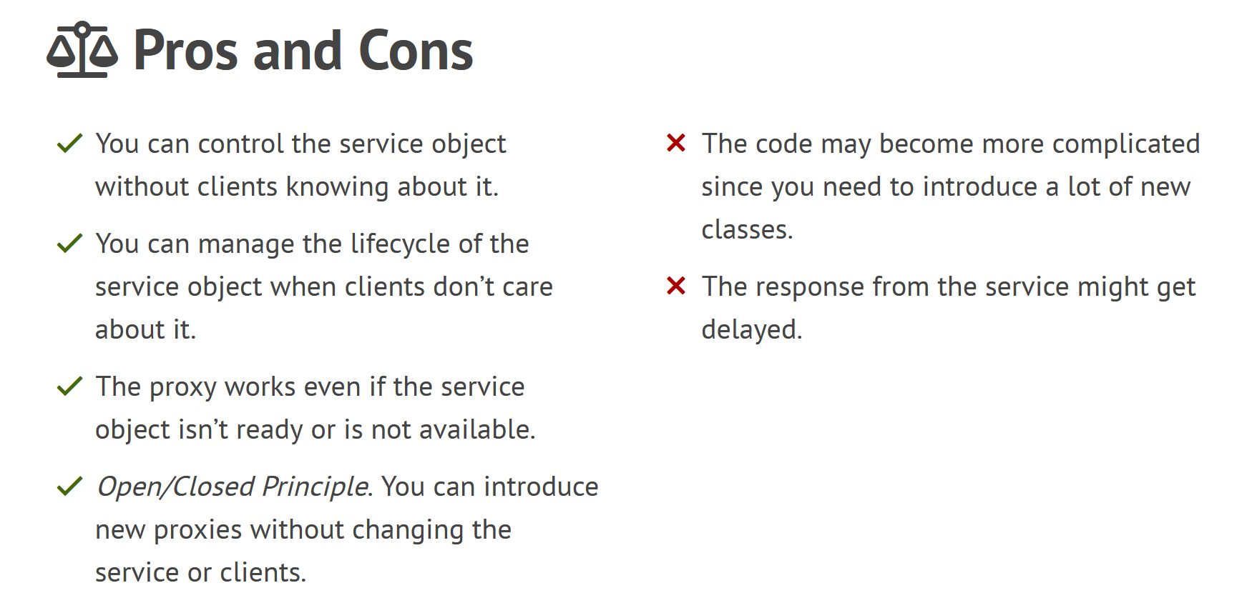
3. Proxy

Slide 13
4. Bridge
Notes:
Proxy lets you provide a substitute or placeholder for another object.
A proxy controls access to the original object, allowing you to perform something either before or after the request gets through to the original object.

